Slide 1
Dogs, Fried Chicken or Blueberry Muffins?
PRESENTED BY Shan He[Group 6]
[Group 6] Linna Yu ；Mengqi Chen; Michael Utomo; Shan He; Yuhao Kang

Slide 2
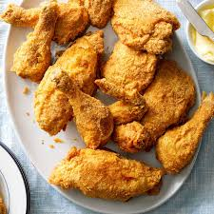
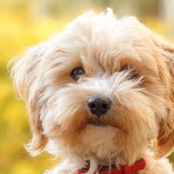
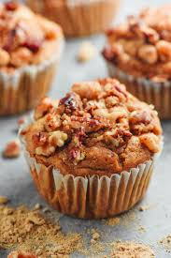
WHAT IT IS?
FIRED CHICKEN?
BLUEBERRY MUFFINS?
DOGS?

Slide 3
Image analysis
How?
SIFT (Scale Invariant Feature Transform)
HOG (Histogram of Oriented Gradients)
RGB Color Model

Slide 4
HOG
01
02
Get the gradient of each pixel; Separate into small cells
Get the histogram of the frequencies of the gradients for each cell
03
Create blocks with several cells, and get the info of the blocks
Combine the info of blocks and get the info of the image
04
HOG

Slide 5
RGB Color Model
Detecting the Color
1
2
3
Assign values to different combinations of colors
Analyzing the color component of a specific cell

Slide 6
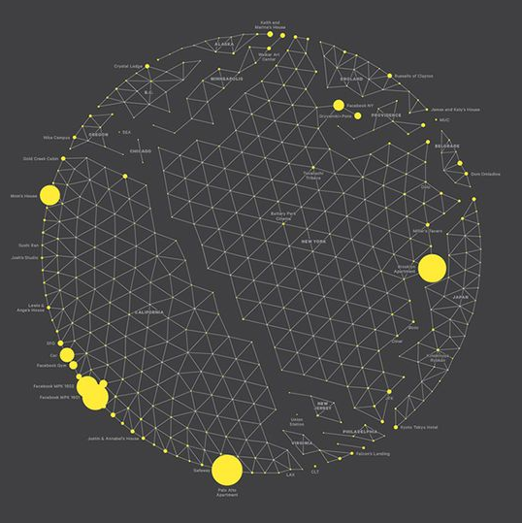
Classification methods
1. GBM
2. SVM
HOW
3. Random Forest
4. Logistic Regression
5. XGBoost
(All first four models are done with 10-fold cross validation , and XGBoost is done with 5 fold cross validation)

Slide 7
Results
Model Running Time
 | GBM | SVM | Random Forest | Logistic Regression | XGBoost
SIFT | 900sec | 606sec | 6843sec | 367sec | 4161sec
HOG | 130sec | 118sec | 466sec | 11.3sec | 899sec
RGB | 289sec | 179sec | 1116sec | 40.8sec | 1843sec

Slide 8
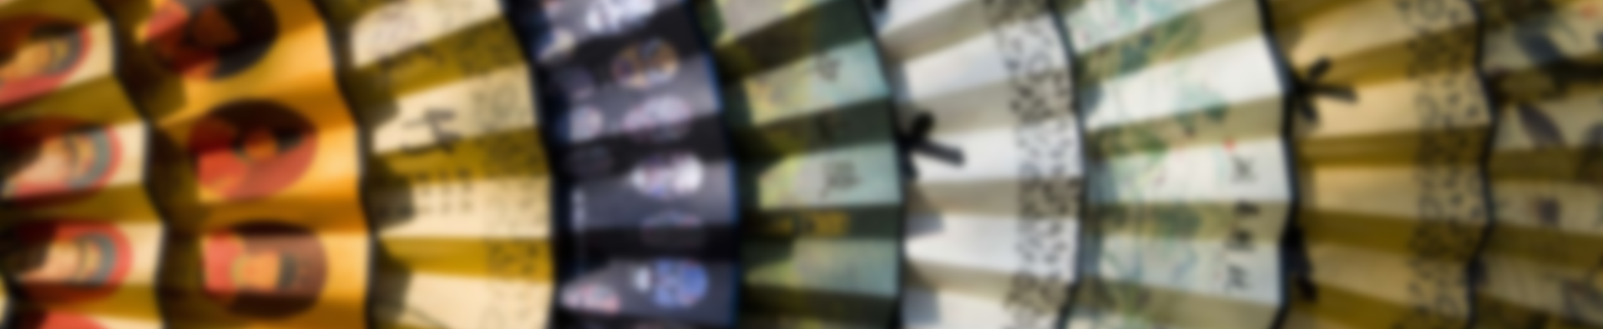
ACCURACY
RESULTS
Testing Accuracy

Slide 9
FINAL DESICION
RGB + GBM
Not time consuming
Highest accuracy among all of the combinations

Slide 10
Why?
why
The pictures are highly different in colors in tiny parts! And we may not see it from our naked eyes!

Slide 11
THANK YOU FOR WATCHING

